Slide 1
Who Deserves to be Equal at Work?
Dr A Tataryn
atataryn@liverpool.ac.uk
University of Liverpool
07.10.2017

Slide 2
Equality Law
Protection in Employment for all?
Gaps: employment law – equality – immigration law
migrant workers, or persons without recognised citizenship status/precarious immigration status
The disintegration of the old industrial model of employment based on the “standard employment relationship” = non-standard contracts, sham employment contracts and atypical work
Notes:
(full time year-round employment for a single employer)

Slide 3
Rhetoric of work and migrant workers
EU citizens
Concept of ‘EU immigrant’ is non-existent in law
“Let language not betray us: European citizens exercising their right to free movement are not ‘immigrants’. All European citizens have the same rights.” Viviane Reding, then Commissioner for Justice, Fundamental Rights and Citizenship
Third-Country Nationals (TCNs)
Precarious workers
Notes:
EU citizens who have the right to travel, live, work and study where ever they want in the Union are put on a par with immigrants from countries outside the EU.

Slide 4
Who Counts
As an employee?
As a worker?
As discriminated against under the Equality Act 2010?

Slide 5
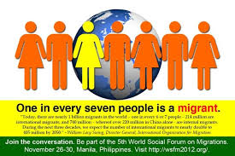
Case law: illegality?
Notes:
Hounga v Allen [2014] SCR

Slide 6
Taiwo v Oliagbe (2016) IRLR 719 SC
s 13(1) Equality Act 2010 ('EA') a person
(A) discriminates against another
(B) if, because of a protected characteristic, A treats B less favourably than A treats or would treat others.
S 9(1): Race includes
(a) colour;
(b) nationality;
(c) ethnic or national origins.

Slide 7
Taiwo v Oliagbe (2016) IRLR 719 SC
Does nationality (S 9.1b) include immigration status?
Immigration status is not a protected characteristic
Modern Slavery Act 2015?
Notes:
SC suggested Modern Slavery Act could grant ability to claim compensation for injury caused by ill treatment based on vulnerable immigration status

Slide 8
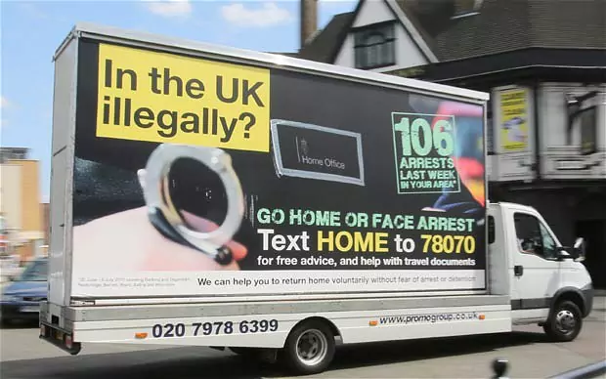
Inside versus outside
in the case of migration, laws and policies do not only ‘manage migration’ but, are critical to the production of social and employment relations (Bridget Anderson, 2017)

Slide 9
Equality for those ‘inside’?
Citizenship as legal status does not equal full inclusion – where is the law going wrong?
Multiple exclusions
Notes:
Experiencing equality in the workplace in practice versus creating ‘more law’, hoping it will be ‘better law’

Slide 10
Law / Economics
More law = better law?
Economic priorities prefer less employment/worker protections
cheaper labour, less benefits, less obligation = more efficient

Slide 11
Questions
Dr A Tataryn
atataryn@liverpool.ac.uk
University of Liverpool
07.10.2017

